Slide 1


Department of Computer Science and Engineering
CS19621 – PRIEE
ANTICIPATORY VEHICLE SERVICING
FORECASTING MAINTENANCE
NEEDS
HARI AMERTHESH N -210701067
KISHORE KARTHIK M -210701123
KRISHNAKUMAR R -210701126

Slide 2
Abstract
In Recent days the Advanced technologies called predictive vehicle maintenance systems (PVMS) enable vehicle owners and operators to identify possible issues with their cars before they arise. These systems track the operation of vital auto parts including engines, brakes, and transmissions using data from numerous sensors and other sources. The owner or operator can take preventive action by analyzing this data to find trends that point to the likelihood of a failure or other problem. Sensors, data processing software, and decision-making algorithms are the three primary parts of PVMS. The sensors gather information on a range of performance metrics for the car, including tyre pressure, oil pressure, and engine temperature, and the vehicle predictive maintenance will reduce the cost efficiency.

Slide 3
Problem Statement and Motivation
Vehicle predictive maintenance systems aim to address several critical issues within the automotive industry, focusing on the reliability, safety, and efficiency of vehicle operation. Unexpected Failures and Breakdowns are predict that Vehicles are prone to unexpected mechanical or electronic failures that can lead to costly repairs, safety hazards, and operational downtime. High Maintenance Costs that schedules often result in either under-maintenance, leading to breakdowns, or over-maintenance, causing unnecessary costs Operational Downtime Unplanned maintenance results in significant downtime for commercial and fleet vehicles, impacting business operations and profitability. Safety Risks like Mechanical failures, particularly in critical components like brakes, engines, and transmission systems.

Slide 4
Objectives
The objective of implementing a vehicle predictive maintenance system encompasses several key goals aimed at improving vehicle performance, reducing costs, and enhancing safety and efficiency. The Proactive Identification of Potential Failures that will Detect and predict potential mechanical or electronic issues before they lead to vehicle breakdowns, ensuring timely intervention and Optimization of Maintenance Schedules that will develop and refine maintenance schedules based on real-time data and predictive analytics to prevent unnecessary maintenance and reduce downtime and Cost Reduction will Minimize maintenance and repair costs by avoiding over-maintenance and reducing the incidence of unexpected failures that require expensive repairs.

Slide 5
Proposed System
We hope to automate the time-consuming task of assessing large amounts of textual feedback from many sources and situations by employing machine learning methods. From consumer reviews and social media comments to employee surveys and product evaluations, this project covers the entire spectrum of input, shedding light on the trends and feelings that influence decision-making. The overarching goal is to give companies the opportunity to generate effective suggestions from feedback data.

Slide 6
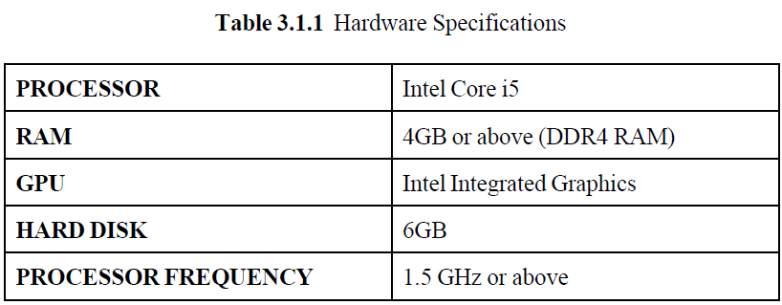
Development Environment

Slide 7
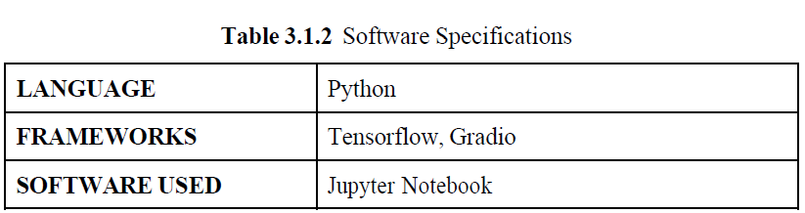
Development Environment

Slide 8
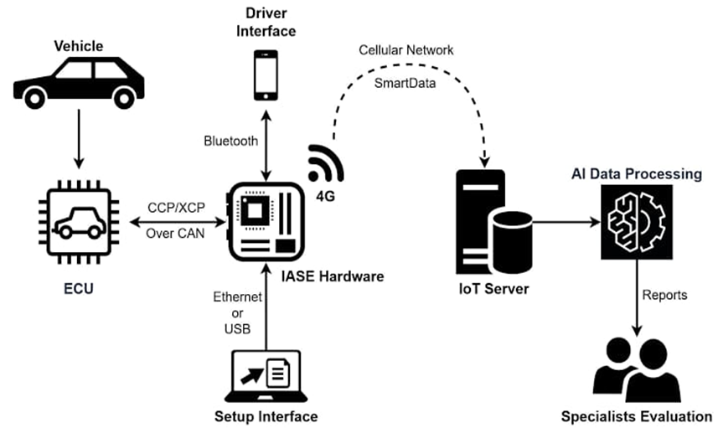
System Architecture

Slide 9
System Workflow

Slide 10
List of Modules
Data Acquisition Module:
Sensor integration collect real-time data from various vehicle sensors (e.g., engine, brakes, transmission, fuel system).
Data Aggregation:
Aggregate data from multiple sources for comprehensive analysis.
Data Storage:
Securely store large volumes of historical and real-time data for analysis and future reference.

Slide 11
Implementation/Results of Module
Implementing a vehicle predictive maintenance system involves several key steps and phases, from initial planning to deployment and continuous improvement. This phase starts with clearly defining the system's goals and objectives, such as reducing unplanned downtime, lowering maintenance costs, and enhancing vehicle safety. It also includes identifying key stakeholders, such as fleet managers, maintenance teams, and IT staff, who will play critical roles throughout the project. Gathering detailed requirements from these stakeholders ensures that the system addresses all necessary aspects, including data sources, reporting needs, and integration points with existing systems. The next phase is designing the system architecture.

Slide 12
Output Screenshots

Slide 13
Output Screenshots

Slide 14
Output Screenshots

Slide 15
Prediction Graph
The output is binary classification that finally classifies the feedback as true or false for various parameters like toxic feedback, severely toxic feedback, insulting feedback or threatening feedback for the given graph

Slide 16
Conclusion
Implementing a vehicle predictive maintenance system brings transformative benefits to vehicle fleet management by leveraging advanced data analytics, machine learning, and IoT technologies. This system proactively identifies potential failures and optimizes maintenance schedules, significantly reducing unplanned downtime and associated costs. By enhancing vehicle reliability and safety, it ensures that critical components are maintained in optimal condition, thus minimizing the risk of accidents and extending vehicle lifespan. The system also streamlines maintenance operations, making efficient use of resources and providing fleet managers with valuable insights for data-driven decision-making. Improved service reliability and operational efficiency lead to higher customer satisfaction, while environmentally sustainable practices result in better fuel efficiency and reduced emissions.

Slide 17
References
[1] S. S. Kshatri, D. Singh, B. Narain, S. Bhatia, M. T. Quasim, and G. R. Sinha, “An Empirical Analysis of Machine Learning Algorithms for Crime Prediction Using Stacked Generalization: A IEEE Access, vol. 9, pp. 67488–67500, 2021, doi: 10.1109/ACCESS.2021.3075140.
[2] S. Andrews, B. Brewster, and T. Day, “Organised crime and social media: a system for detecting, corroborating and visualising weak signals of ,” Secur Inform, vol. 7, no. 1, Dec. 2018, doi: 10.1186/s13388-018- 0032-8.

Slide 18
Paper Publication Status (Phase-I & Phase-II)
The concept and application of predictive maintenance in vehicles have been extensively explored in recent academic and industrial research.
Recent publications, such as those in MDPI's "Machines" journal and SAE Technical Papers, highlight the growing interest and advancements in this field.
For instance, a study on digital twin technology for predictive maintenance has been published in "Machines," emphasizing the integration of real-time data and virtual simulations to enhance maintenance strategies.
Additionally, SAE has published technical papers that review the application of digital twins and predictive maintenance in the automotive sector, showcasing various methodologies and their benefits.

Slide 19
Thank You

